Slide 1
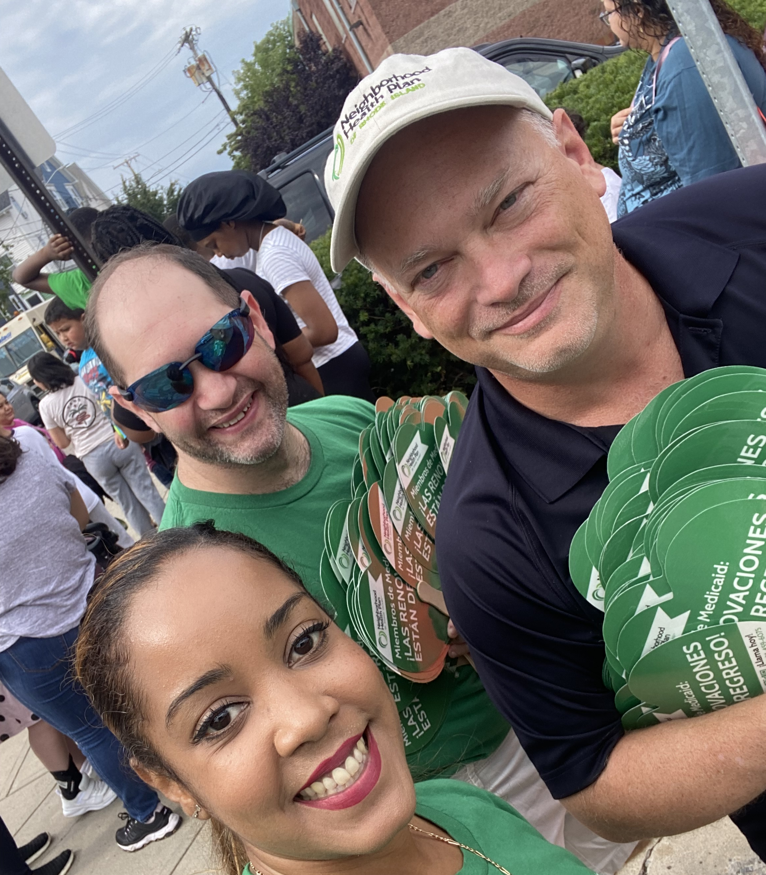
Help
Distribute
Backpacks to students!

