Slide 1
All Staff Meeting
Thursday, October 17, 2024

Slide 2
Welcome & Opening Remarks
Peter Marino
President & CEO

Slide 3
Agenda – October 17, 2024
Welcome and Opening Remarks | Peter Marino
Finance Conversation | Michelle Sears
Introducing ICHRA | Elizabeth McClaine
Health Equity | Rena Sheehan & Vicki Verdi
2024 Engagement Survey Results | Jason Vlaun
Closing Remarks | Peter Marino

Slide 4
Finance Conversation
Michelle Sears
Chief Financial Officer

Slide 5
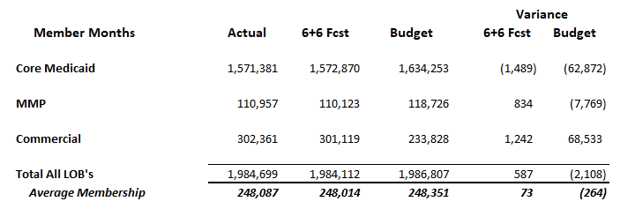

September Member Information

Slide 6
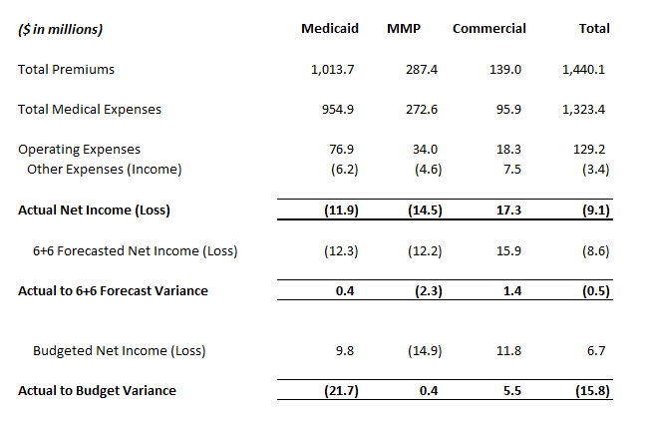


September Financial Results

Slide 7
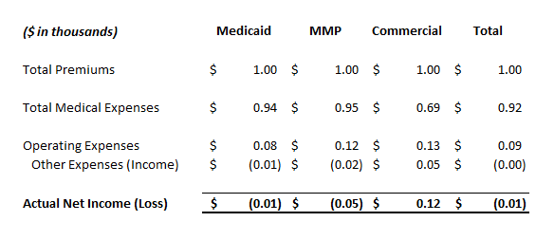
For Every Dollar…

Slide 8
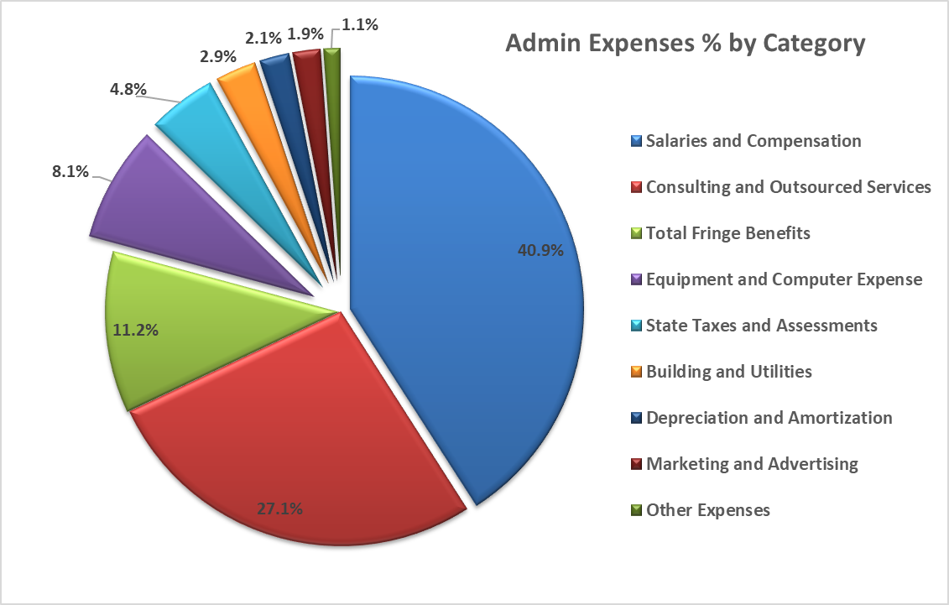
Where Do Those Admin Dollars Go?

Slide 9
Introducing ICHRA:
2025 Individual Market Portfolio Expansion
Elizabeth McClaine
Vice President of Commercial and Medicaid Products

Slide 10
Commercial Products Offerings
2025 NEW!
Individual & Family Plans “On Exchange”
Individual & Family Plans “Off Exchange”
Small Business Plans “On Exchange”
Enrollment through HealthSource RI
Members who do not have access to group coverage
Members can receive Advanced Premium Tax Credits (APTC) and Cost Sharing Reduction plans (CSR) based of age and income
Individual and family plans accessible through ICHRAs
Small business plans for employers with 50 or less employees

Slide 11




What is an ICHRA?
Individual Coverage Health Reimbursement Arrangement
A type of health reimbursement account for employers
Employers contribute
a fixed amount in account
for employees
Employees choose
their own health plans
from individual market
Budget-friendly, hassle-free quality health insurance

Slide 12





Employer Advantages of an ICHRA
More financial control
and predictability
Simple administration
for employers
No maximum contribution
per employee class
Employers can contribute different amounts to different employee types with no cap
Fixed financial contributions
so employers can budget for and define increase
Employers do not have to choose
a single plan for all employees
for diverse health care needs

Slide 13






Employee Advantages of an ICHRA
Employees choose their own health plan
Tax advantages to employers and employees
Health benefits for part-time and hourly employees
Employees select an individual market plan that is best for them and their family.
Contributions do not count toward employees’ taxable wages
Flexible contributions for part-time, seasonal and hourly employees

Slide 14
Neighborhood Opportunities
Utilizes Neighborhood’s current Individual portfolio of plan designs
Market includes both small and large groups
Niche Opportunity – no other RI plans embracing this space
Growth in Individual market with potential to positively impact margin reinsurance and risk adjustment

Slide 15
Neighborhood: Market-share opportunities
No employer size limit to participate. Neighborhood can offer plans to employers larger than 50 without offering Large group plans
Highest adoption of ICHRAs is new businesses, start-ups, and micro businesses
Coverage options available for part-time/seasonal employees, as well employees working remotely in RI
Community-based organizations could benefit from fixed dollar contributions

Slide 16
HSA Insurance Partnership
Strategic off-Exchange partnership already established – HSA Insurance
HSA has off-Exchange platform up and running, offering ICHRAs since 2020
Platform includes broker portal, enrollment functionality & premium billing
HSA has brokers and businesses requesting RI plan offerings
HSA is connected to 7 Third Party Administrators (TPAs) that will sell plans
Number of brokers offering ICHRAs through HSA platform 7X since 2020

Slide 17
Neighborhood’s Commitment to Health Equity
Rena Sheehan
Vice President of Clinical Strategy and Implementation
Vicki Verdi
Health Equity Program Manager

Slide 18
Health Equity
Vision: Accelerate our commitment to Health Equity so every Rhode Islander, regardless of race, ethnicity, socioeconomic status, and gender has the opportunity to achieve their highest potential for health.

Slide 19
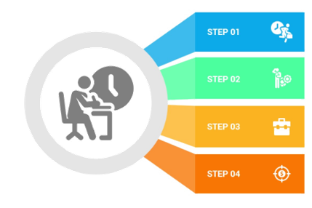
Health Equity Priorities
Model Contract Requirements
QI & NCQA Accreditation
CMS HEI
& Final Rule
4Report

Slide 20
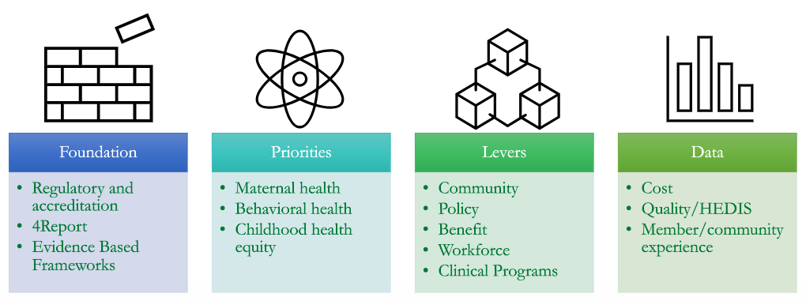
Framework

Slide 21
People in Place
Advisory Committees
Internal Advisory
Goal: Internal stakeholders to shape
approach and inform ​tactics ​
Steering Committee
Workgroups
Goal: Align on strategy, review and discuss defined dashboard
with key metrics​
Goal: Drives strategy, tactics, reporting and project management
External Advisory
Goal: External health equity leaders to provide expertise to help drive goals​ and will be added to workgroups as needed

Slide 22

Subject Matter Experts Drive the Work
Each workgroup will also engage with Marketing, Policy, Care Management, Products & Benefits, Providers, etc. and work directly with our community partners monthly
Maternal
Health
Michelle Bicket & Vicki Verdi
Subject Matter Expert & Health Equity
Jen Clair & Nidhi Patel
Quality Improvement/Data
Holly Picard
Project Manager
Community Partners
Women & Infants, Doula Network, SISTA Fire
Behavioral
Health
Tracy Vadeboncoeur & Vicki Verdi Subject Matter Expert & Health Equity
Joe Horne & Mary Rosa
QI/Data
Holly Picard
Project Manager
Julianne Voss, Rachel Hallene
& Erica Prino Case Managers
Community Partners
CCBHCs, HEZ, Housing Network of RI,
Progreso Latino
Childhood
Health Equity
Bright Osajie & Vicki Verdi
Subject Matter Expert & Health Equity
Angelica Spinazzola
Quality Improvement/Data
Holly Picard
Project Manager
Night Cha & Kathi York
Case Managers
Community Partners
United Way, Meals on Wheels,
RI KidsCount

Slide 23
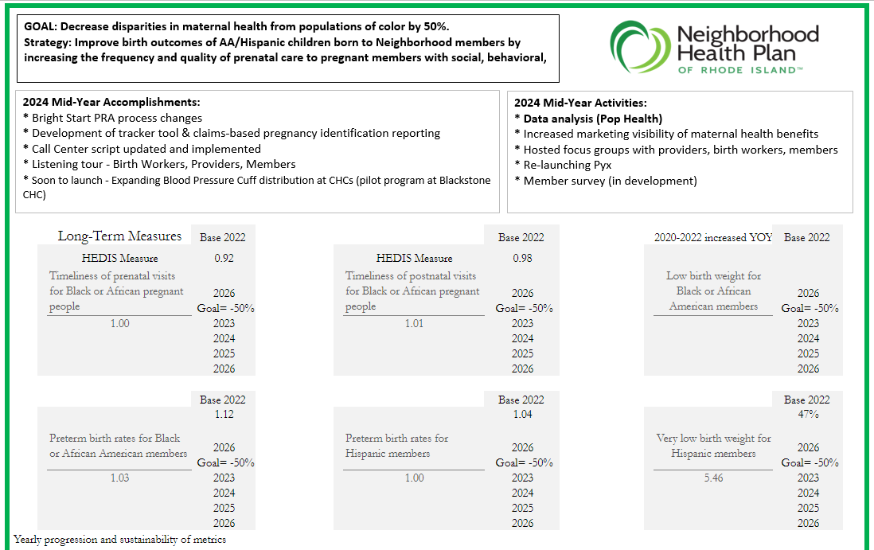
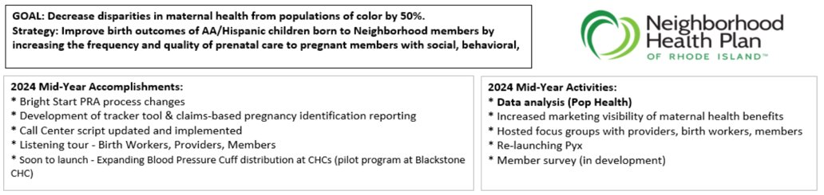
Health Equity Dashboard

Slide 24
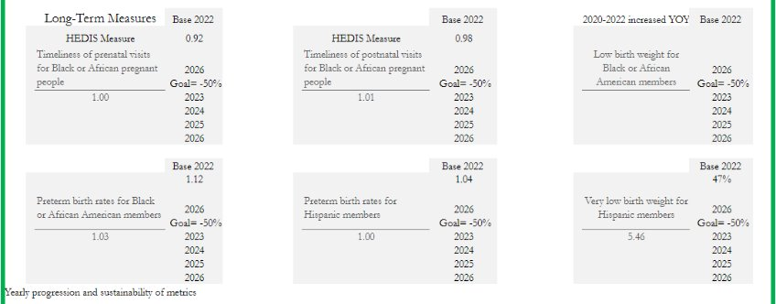
Health Equity Dashboard

Slide 25
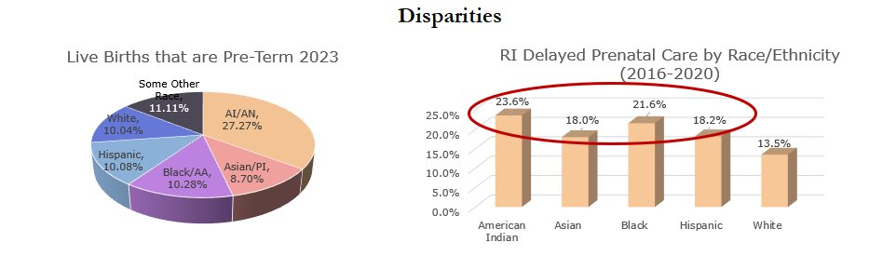
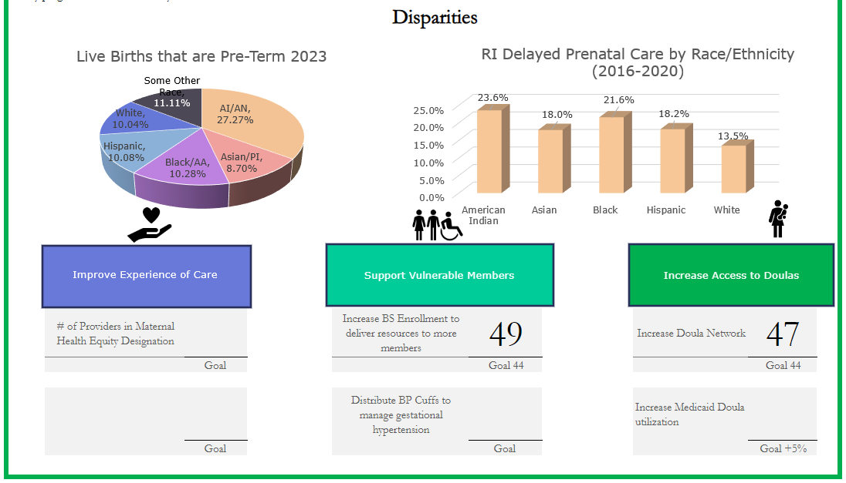
Technology

Slide 26
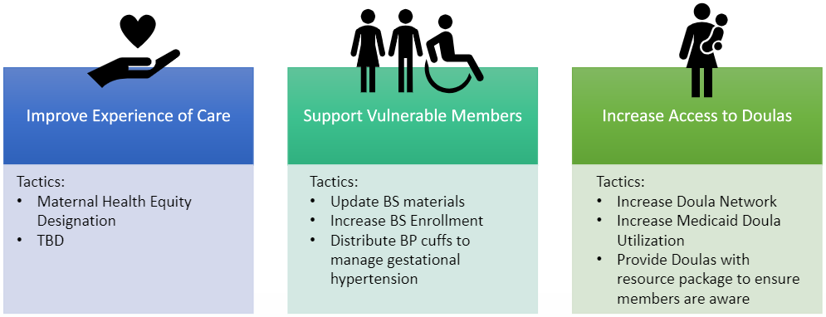
Technology

Slide 27
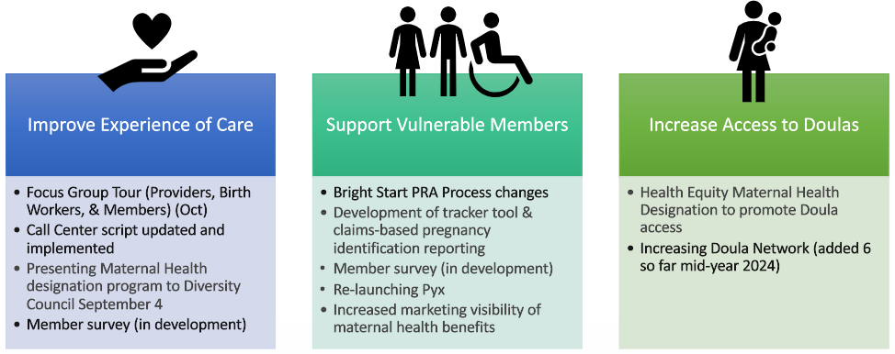
Maternal Health Accomplishments to Date

Slide 28
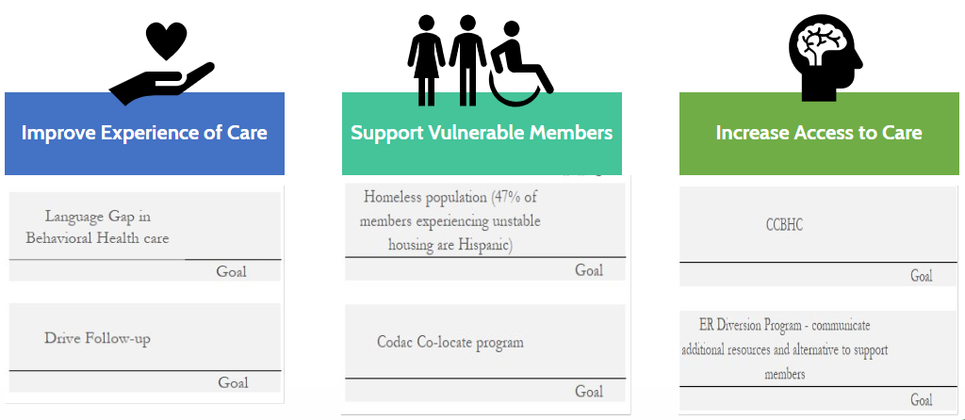
Behavioral Health

Slide 29
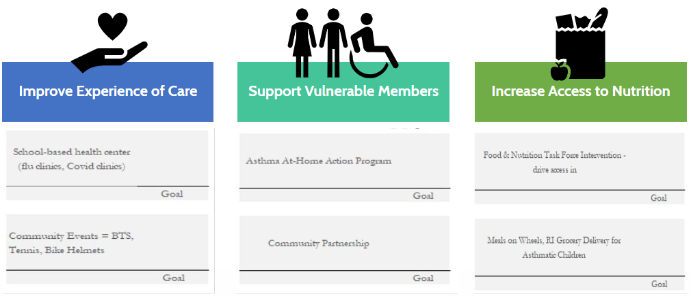
Childhood Health Equity

Slide 30
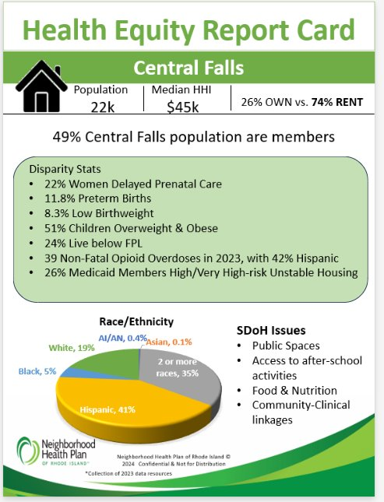
Health Equity
Report Cards

Slide 31
2024 Engagement Survey Results
Your Voice Matters!
Jason Vlaun
Chief Human Resource Officer

Slide 32
2024 Organizational Goal #4
Enable Exceptional Member, Provider and Employee Experience
Employee Experience: Net Promoter Score Measure
  Achieve +25 or better NPS in 2024 Employee Engagement Survey
  5-year goal is to achieve NPS within Good range of 0-49 range
Employees who are consistently satisfied with Neighborhood’s delivery of the services that matter most to them.
Not Measured
21 NPS
GOOD
19 NPS
GOOD
September 2022
August 2023
December 2023
32 NPS
GOOD
April 2024
30 NPS
GOOD
September 2024

Slide 33
2024 4Report Scorecard Area of Focus
Employee Experience: Inclusivity Score Measure
  Maintain or increase the baseline of Neighborhood’s 72% inclusivity score
  based on the Employee Engagement Survey
72%
Not Measured
Not Measured
September 2022
August 2023
December 2023
74%
April 2024
75%
September 2024

Slide 34
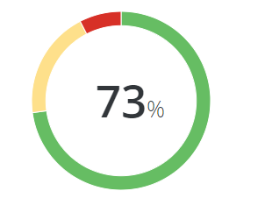
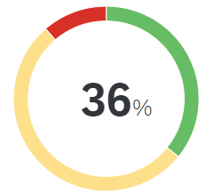
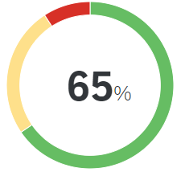
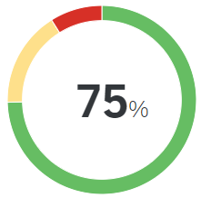
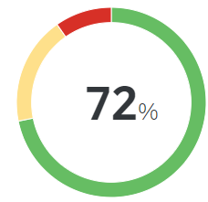
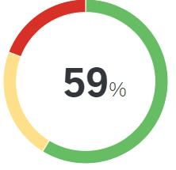
Overall Scores: Key Performance Indicators (KPIs)
Indicates score compared to 2022 Annual Engagement Results
Employee Engagement
Experience vs. Expectations
Intent to Stay
Inclusion
Well-being
Burnout*
*New KPI for Healthcare Provider/Services Industry
% favorable
% neutral
% unfavorable

Slide 35
Highest Scoring Questions
I believe in Neighborhood’s values
I feel safe while
I am at work
My direct supervisor’s actions show
a commitment to safety
I am proud of Neighborhood’s efforts to have a positive impact on the world
I would recommend Neighborhood’s products and/or services to people I know
93% favorable
93% favorable
90% favorable
89% favorable
89% favorable

Slide 36
Lowest Scoring Questions
Overall, to what extent does your experience working at Neighborhood meet your expectations
My pay is clearly linked to my performance
There is effective collaboration between teams
There is open
and honest communication
Work processes allow employees to be as productive
as possible
36% favorable
50% favorable
51% favorable
52% favorable
53% favorable

Slide 37
Lowest Scoring Questions
Indicates score compared to 2022 Annual Engagement Results
 | Overall, to what extent does your experience working at Neighborhood meet your expectations | My pay is clearly linked to my performance | There is effective collaboration between teams | There is open and honest communication | Work processes allow employees to be as productive as possible
2024 Neighborhood Performance | 36% | 50% | 51% | 52% | 53%
2022 Neighborhood Performance | 33% | 52% | 49% | 49% | 51%

Slide 38
Key Takeaways
  Strengths
    Overall eNPS remains a strong point with exceeding our target at +30
    In general, colleagues continue to have favorable support of Neighborhood’s products and services
    Colleagues have trusting relationships & see the link between their work and the strategic plan
    Colleagues with LOS 5+ years have more favorable results
  Areas Identified as Low Performing and Important for NPS
    I feel supported in my efforts to adapt to organizational changes
    Overall, I feel that my career goals can be met at Neighborhood
    There is open and honest communication at Neighborhood
      Prioritizing our improvement initiatives in these areas will have the greatest impact on our eNPS
  Action
    EX Workgroup to deep dive into September 2024 Annual Employee Experience Engagement Results
    EX Workgroup to prioritize Neighborhood’s strengths and opportunities related to results of survey Provide managers/leaders with the tools necessary to leverage information to make
    data-driven decisions and develop comprehensive action planning

Slide 39
Closing Remarks
Peter Marino
CEO & President

Slide 40

Employee Appreciation Week
Our employees are “ToTaLlY aWeSoMe!”
October 28-31, 2024
Stay tuned for the full schedule
of fun employee events in NeighborlyNEWS!
Employee Appreciation Gala on November 2

Slide 41
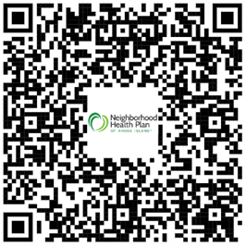
EXPERIENCE MANAGEMENT IN ACTION!
TAKE THE SURVEY TO LET US KNOW
WHAT YOU THINK OF ALL STAFF MEETINGS
- LINK ALSO IN NEIGHBORLYNEWS -

